Slide 1
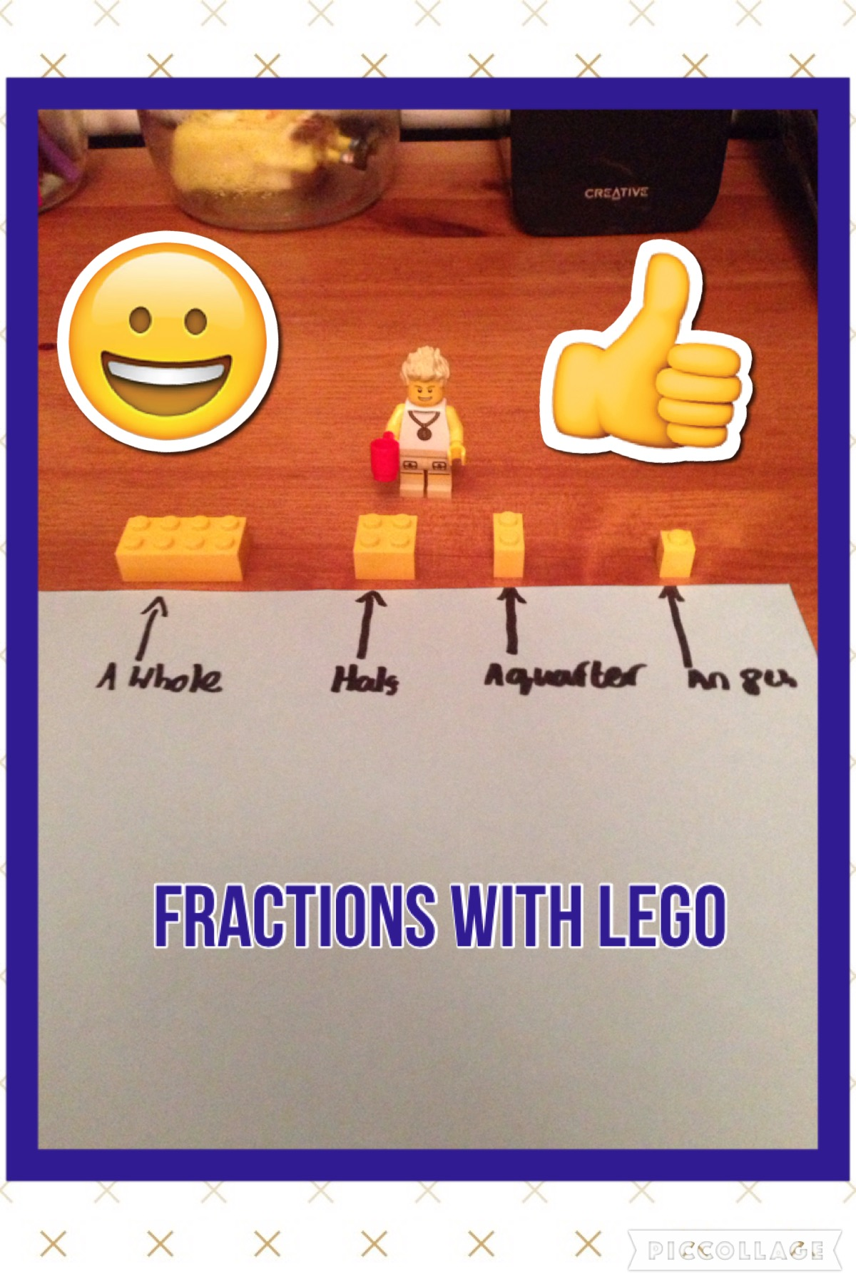

Slide 2
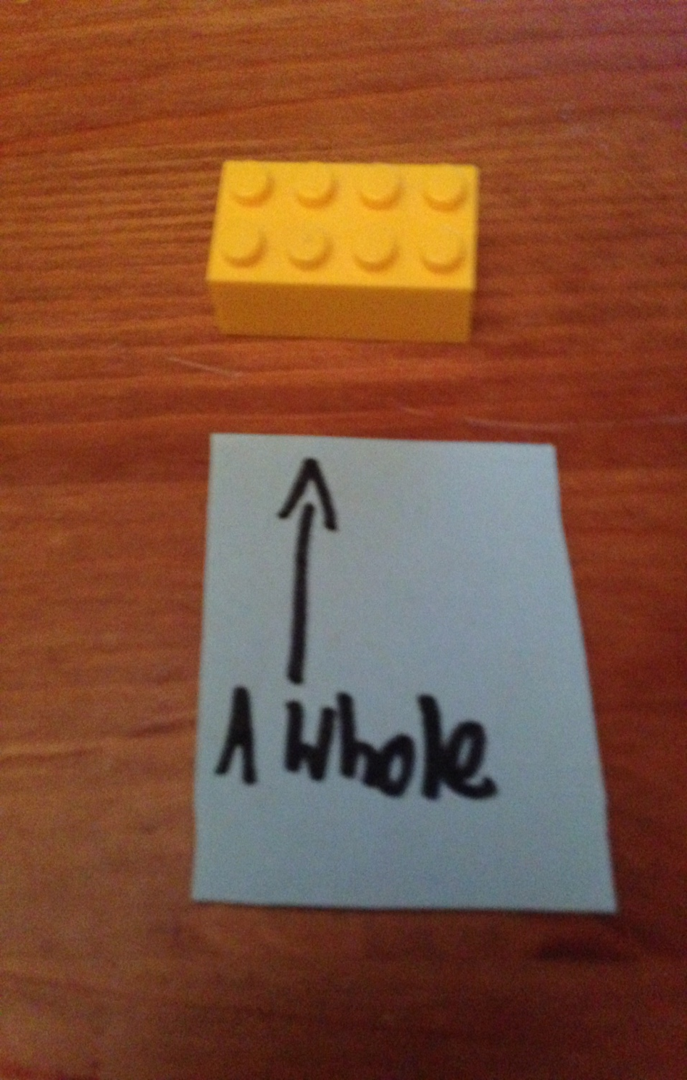
A whole is a shape
That hasn’t been cut
Into fractions at all

Slide 3
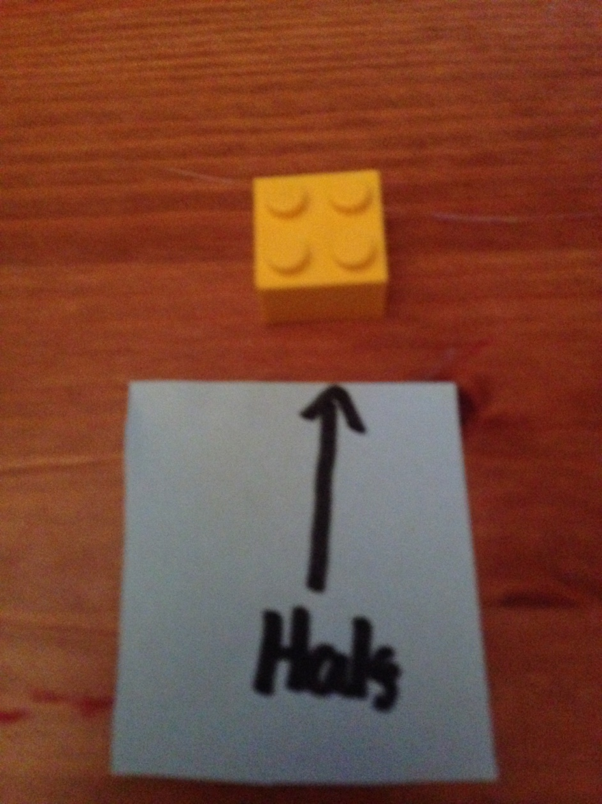
A half is a whole cut
With an even amount on
Each side once it has been cut in half

Slide 4
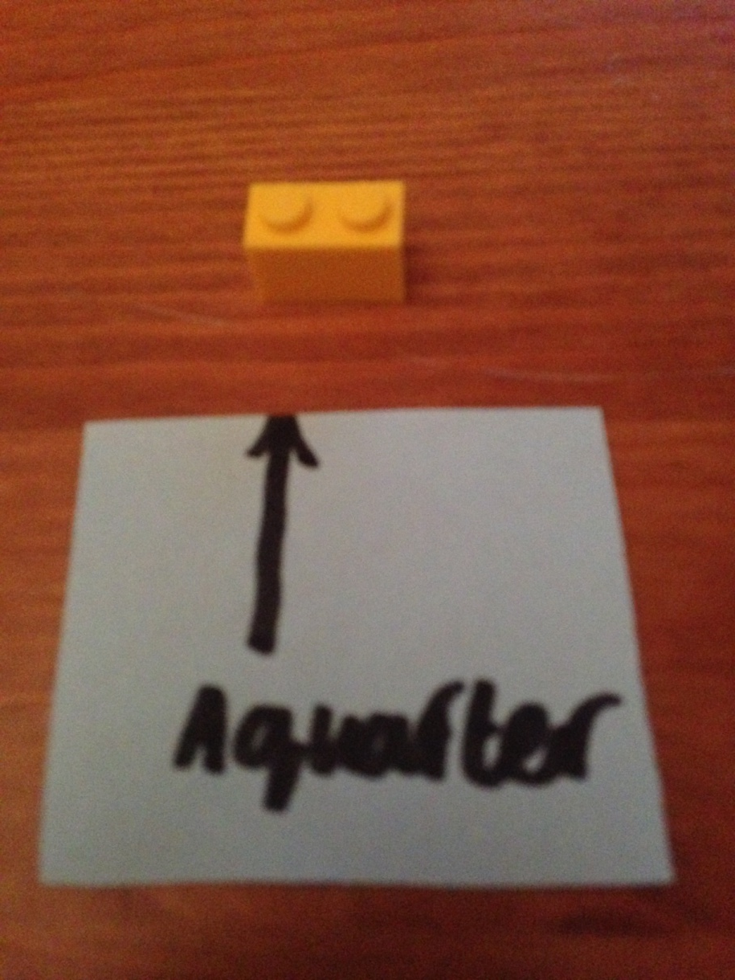
A quarter is
A half cut in half
again

Slide 5
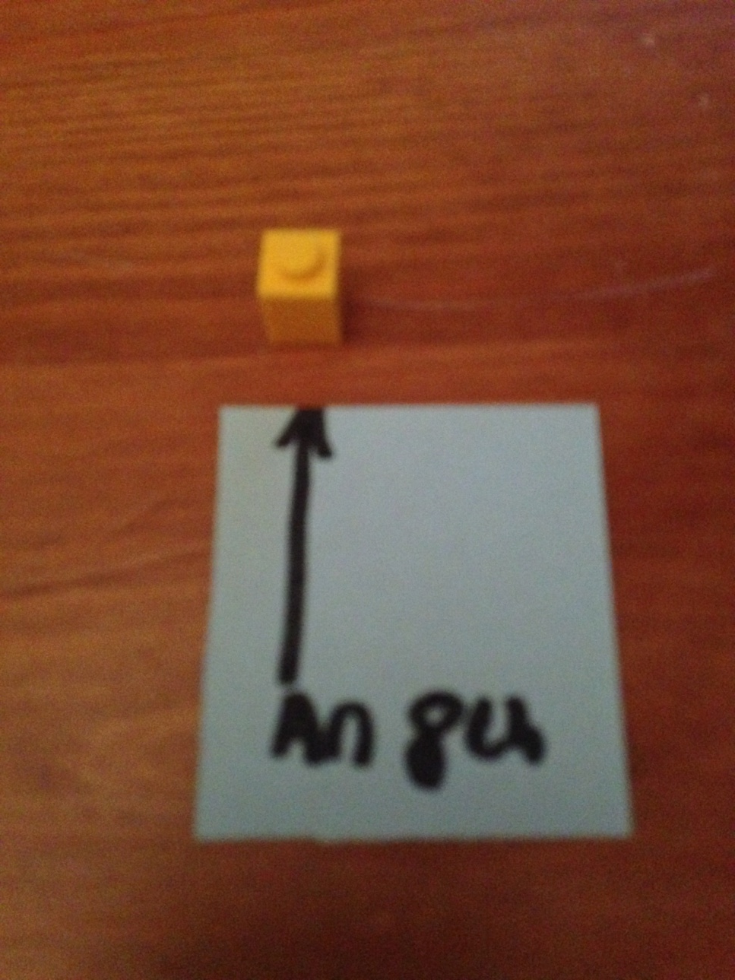
An 8th is a quarter
Cut in half

Slide 6


